Slide 1

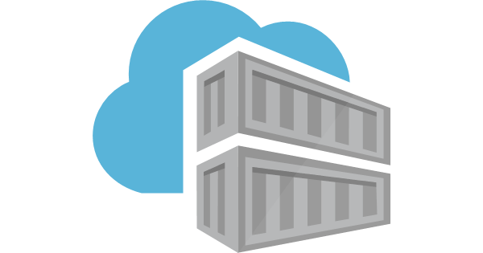

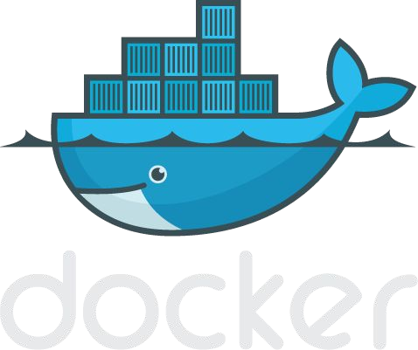
Docker Components
Notes:
<number>

Slide 2
Docker can build images automatically by reading the instructions from a Dockerfile.
A Dockerfile is a text document that contains all the commands a user could call on the command line to assemble an image.
Dockerfile:Dockerfile is a simple text file that consists of instructions to build Docker images.
Mentioned below is the syntax of a Dockerfile:
Syntax
# comments
command argument argument1...
Example
# Print "Get Certified. Get Ahead"
Run echo "Get Certified. Get Ahead"
Now, let's have a look at how to build a Docker image using a dockerfile.

Slide 3
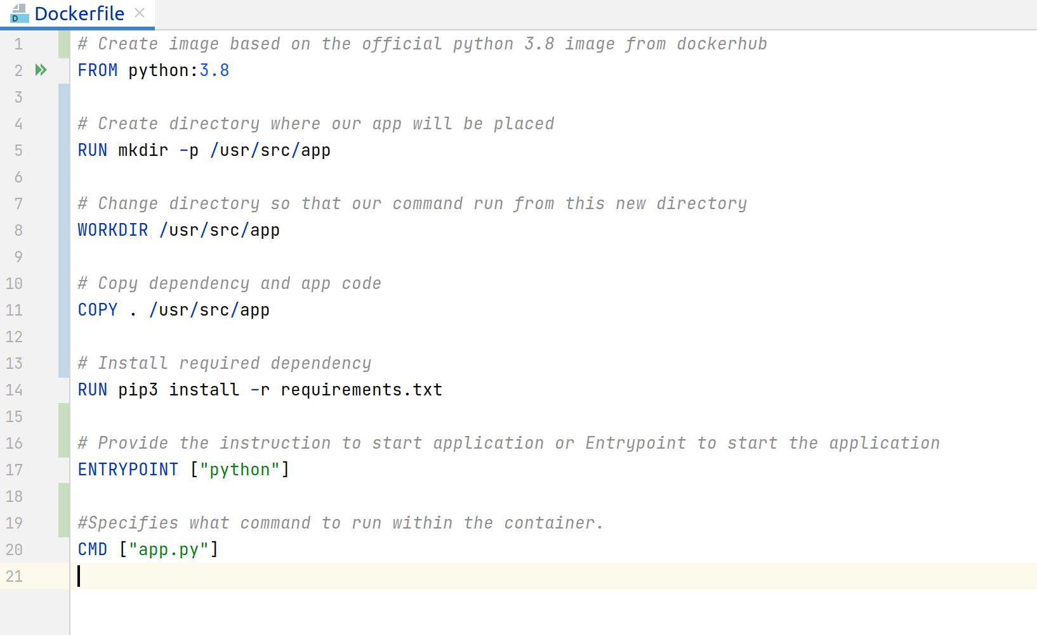

Slide 4
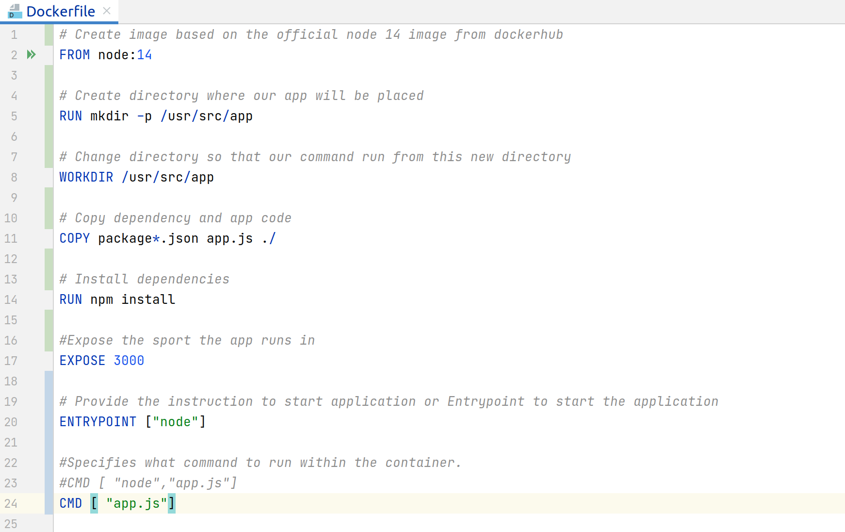

Slide 5
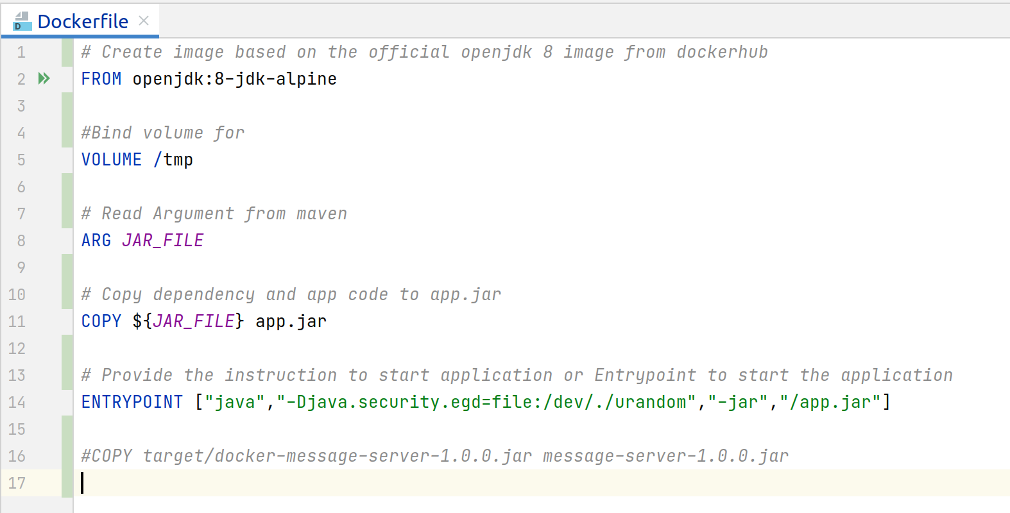

Slide 6
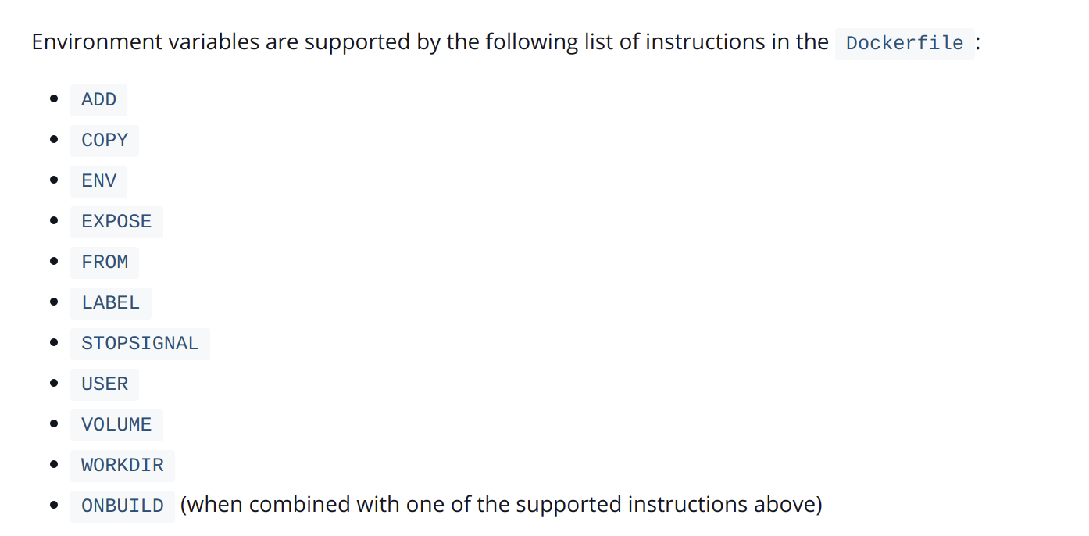

Slide 7
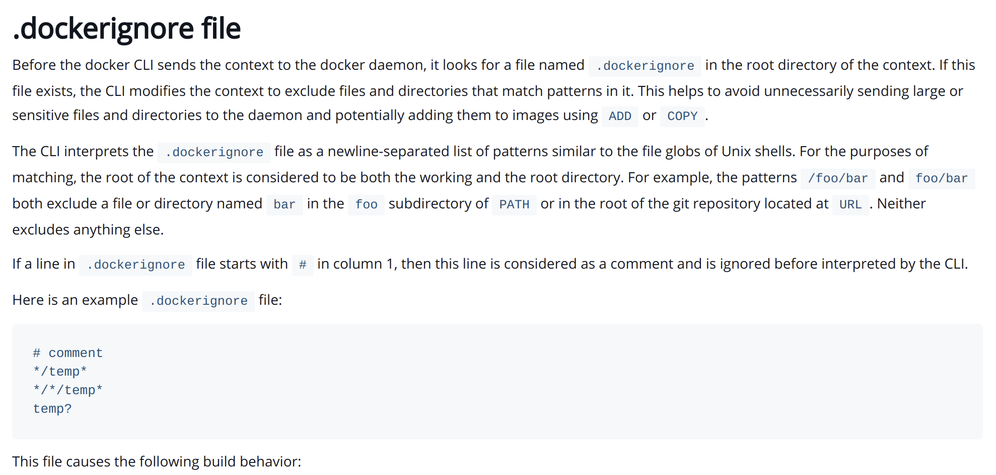

Slide 8
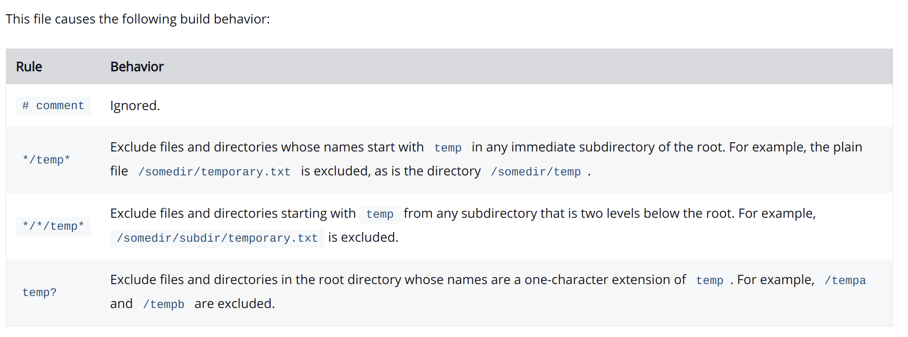

Slide 9
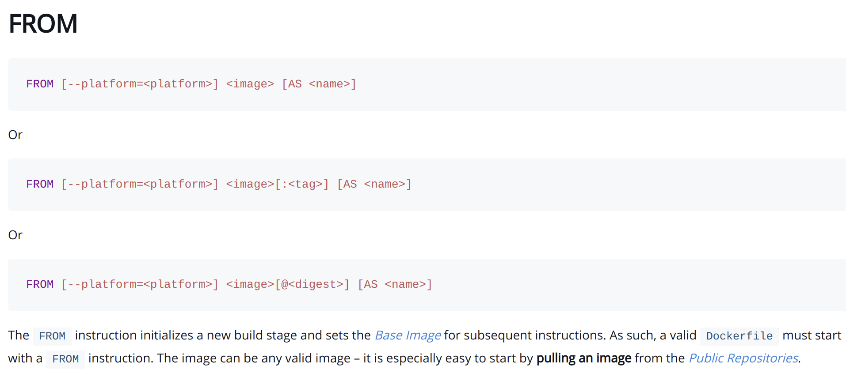

Slide 10
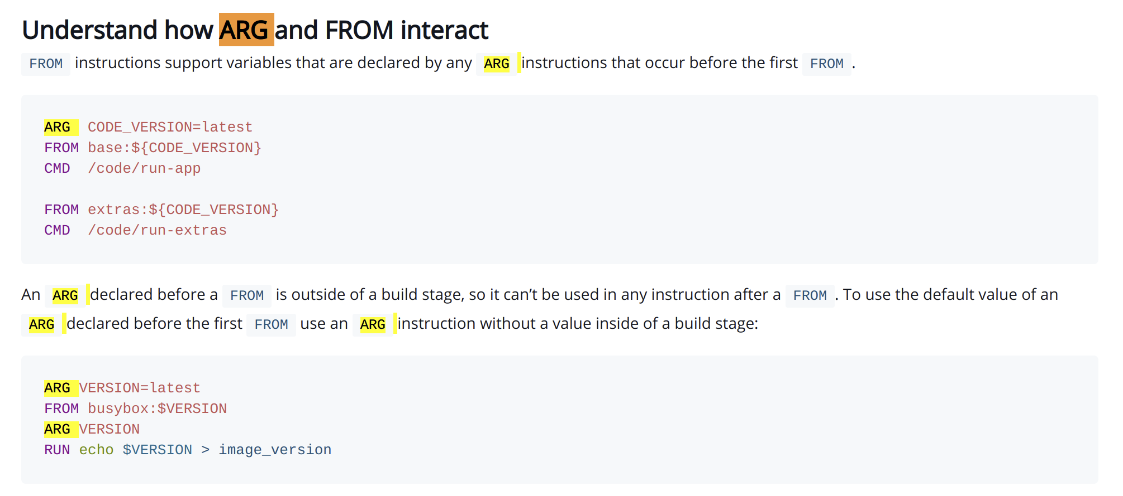

Slide 11
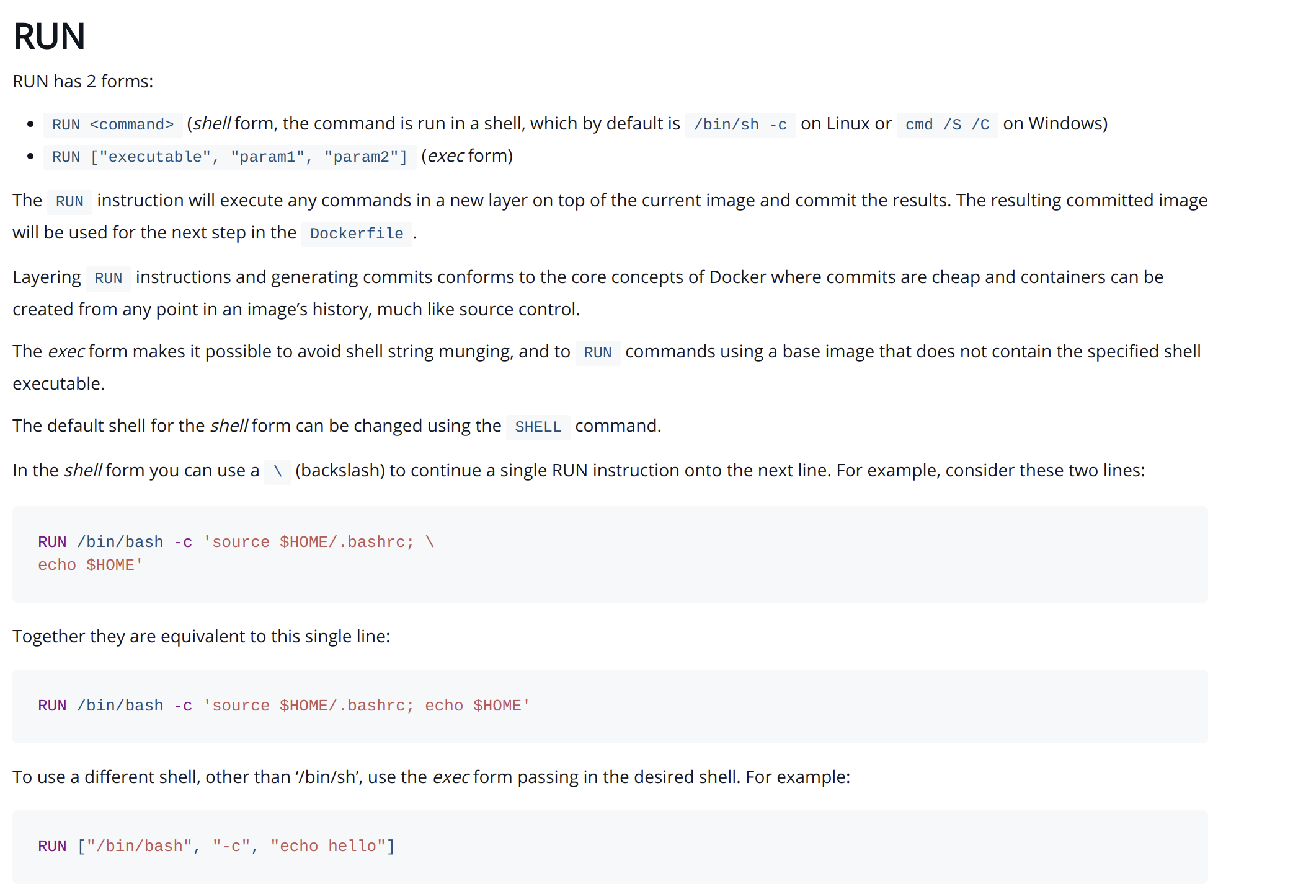

Slide 12
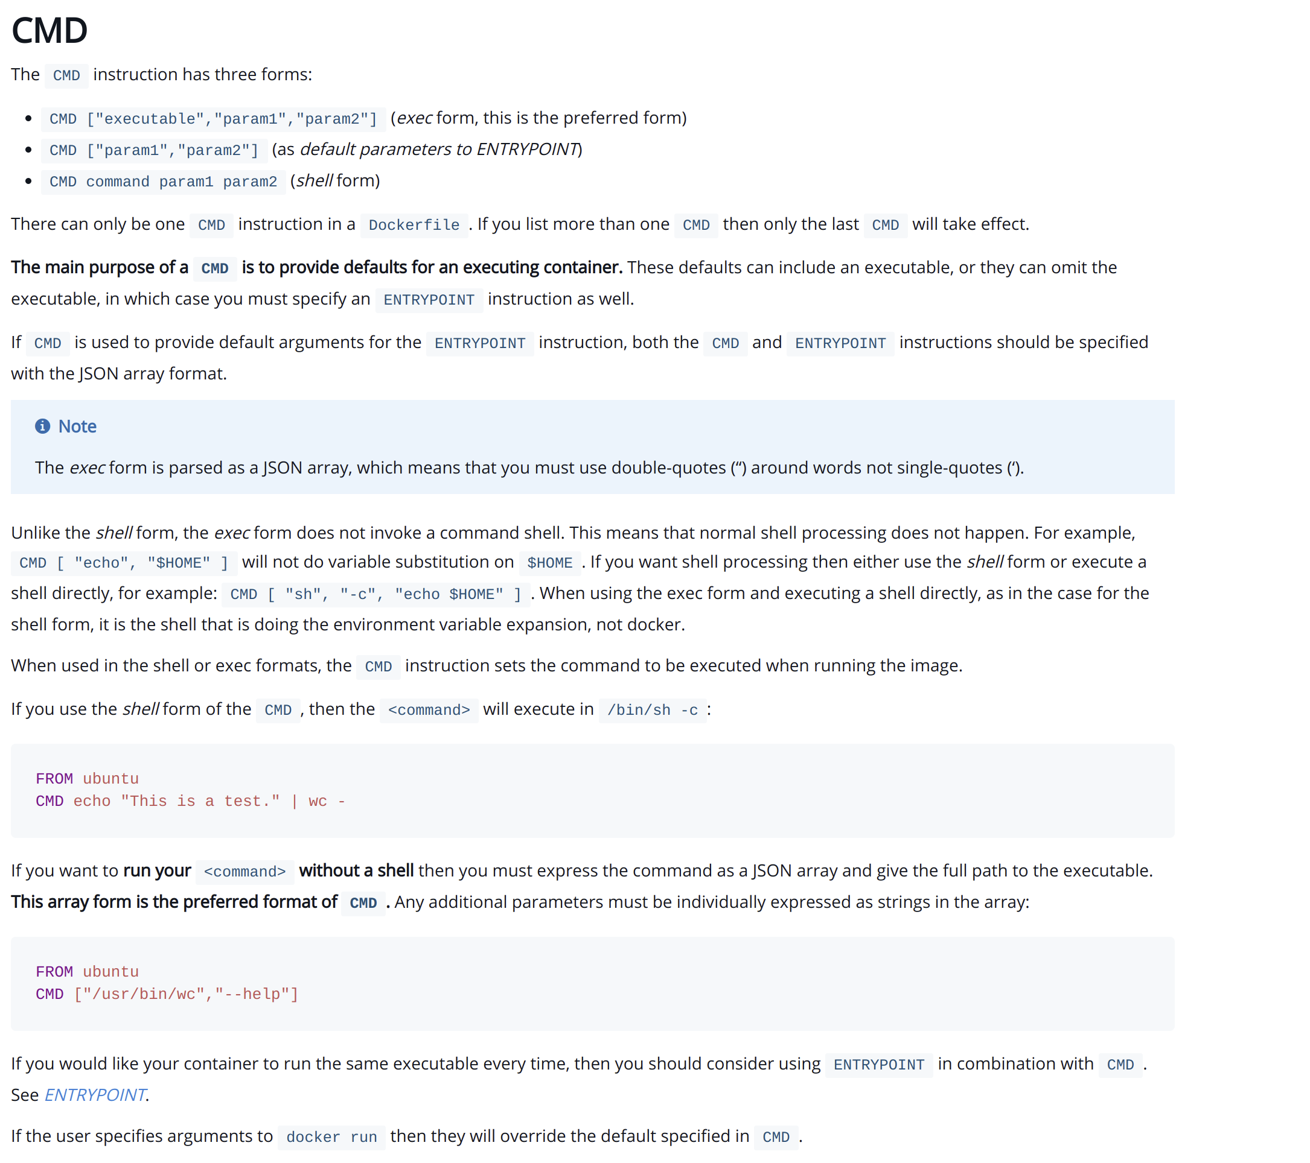

Slide 13
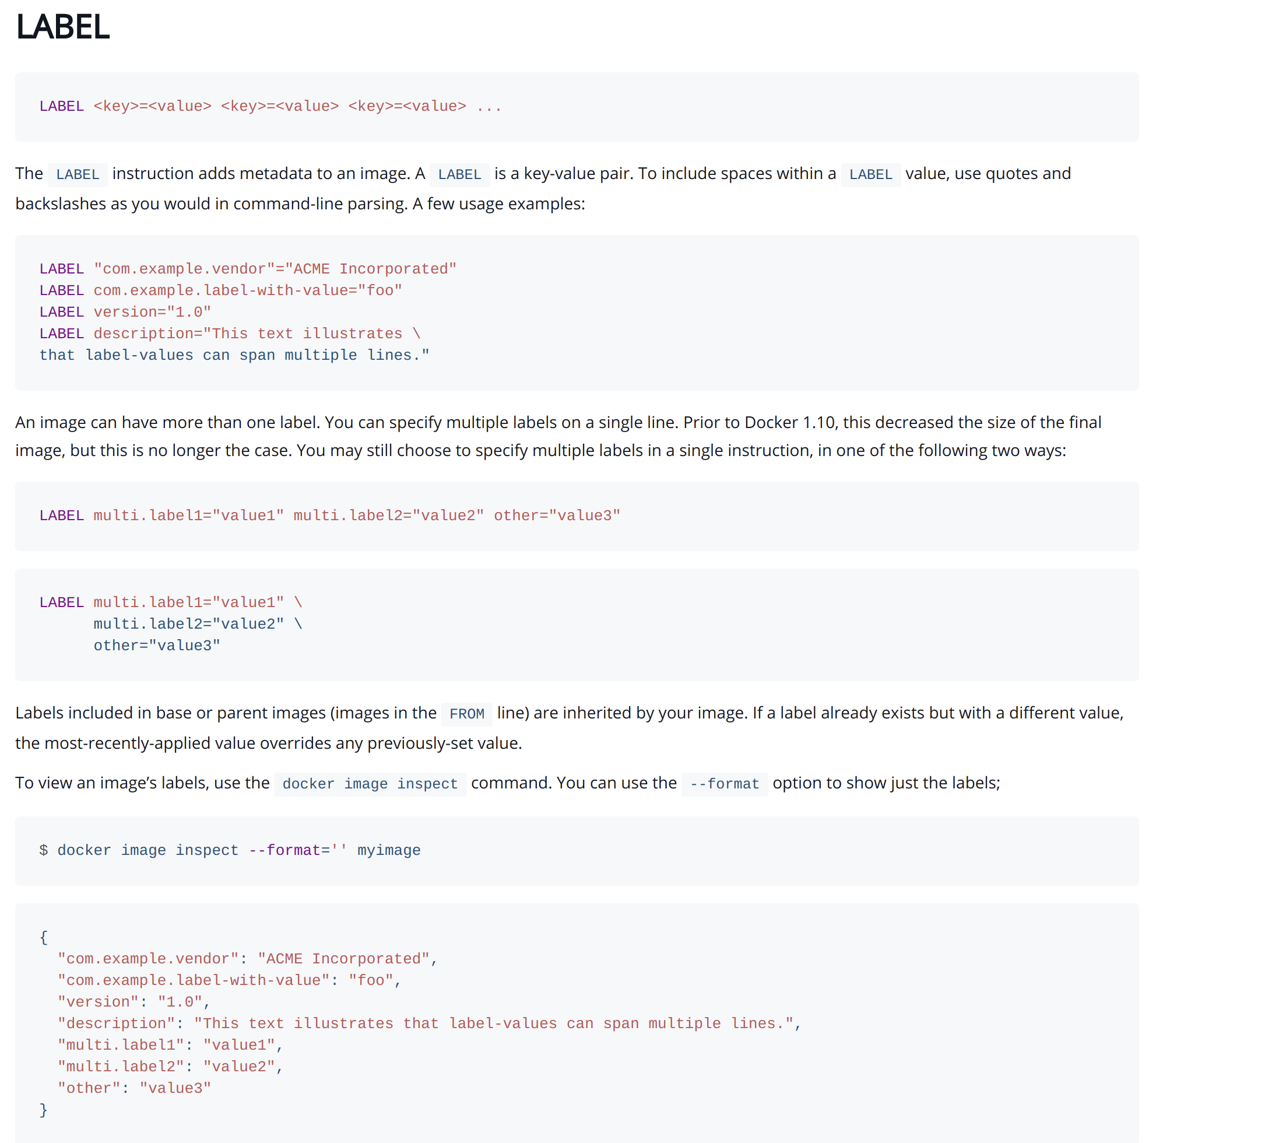

Slide 14
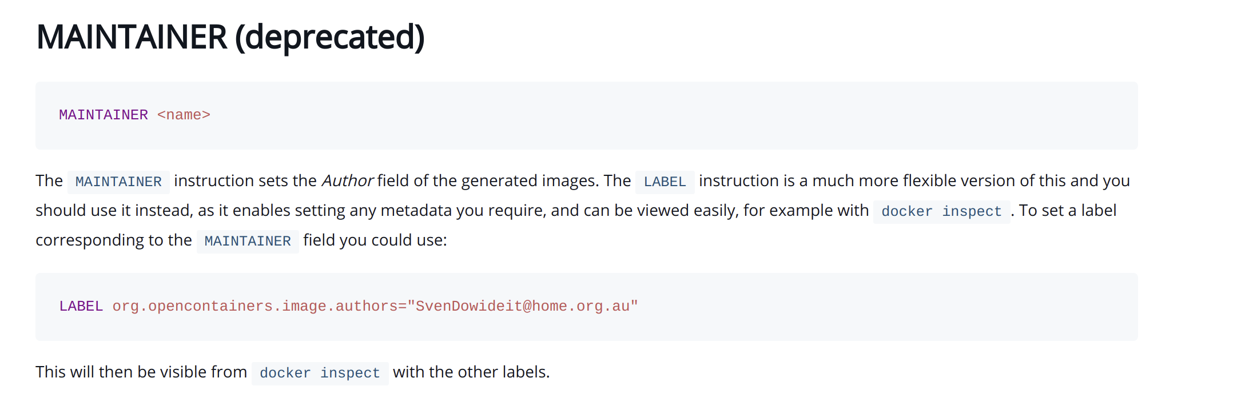

Slide 15
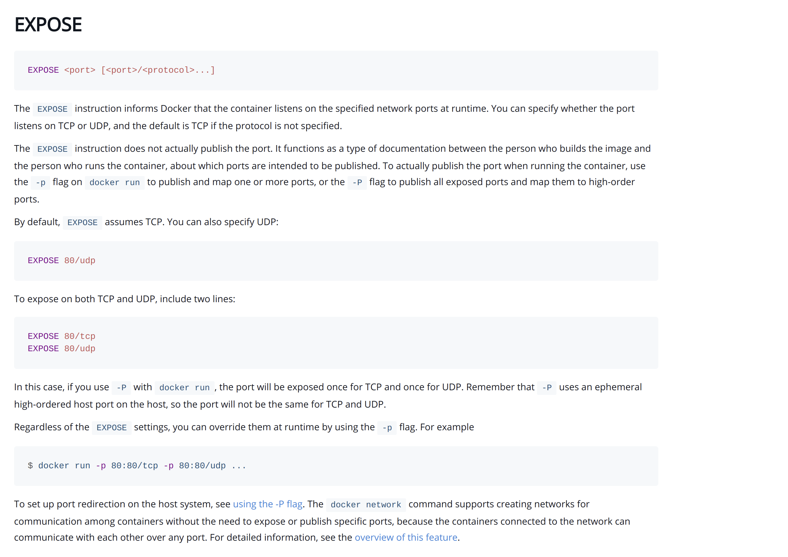

Slide 16
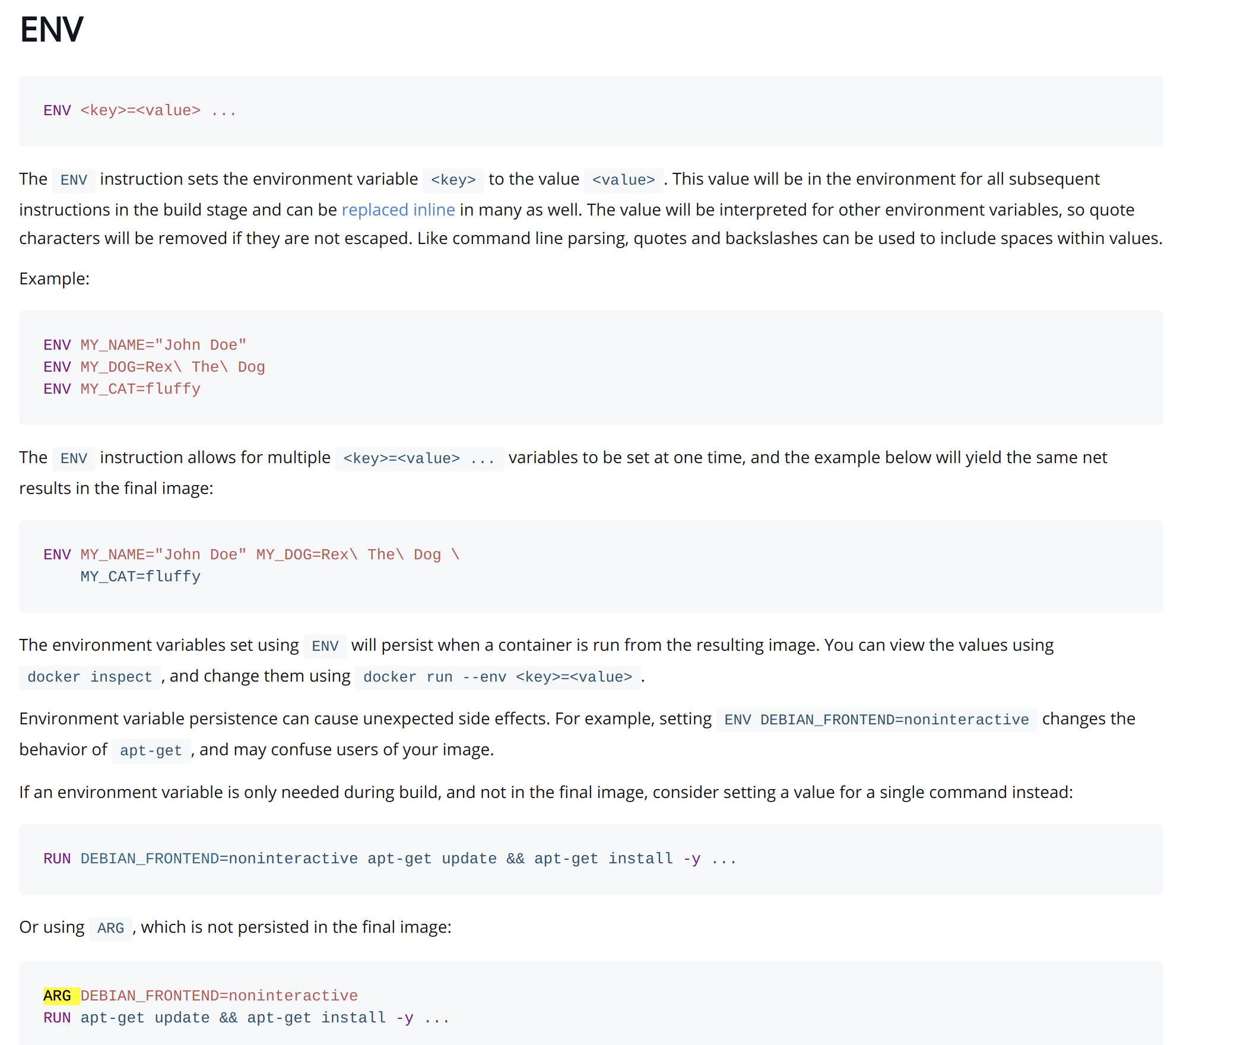

Slide 17
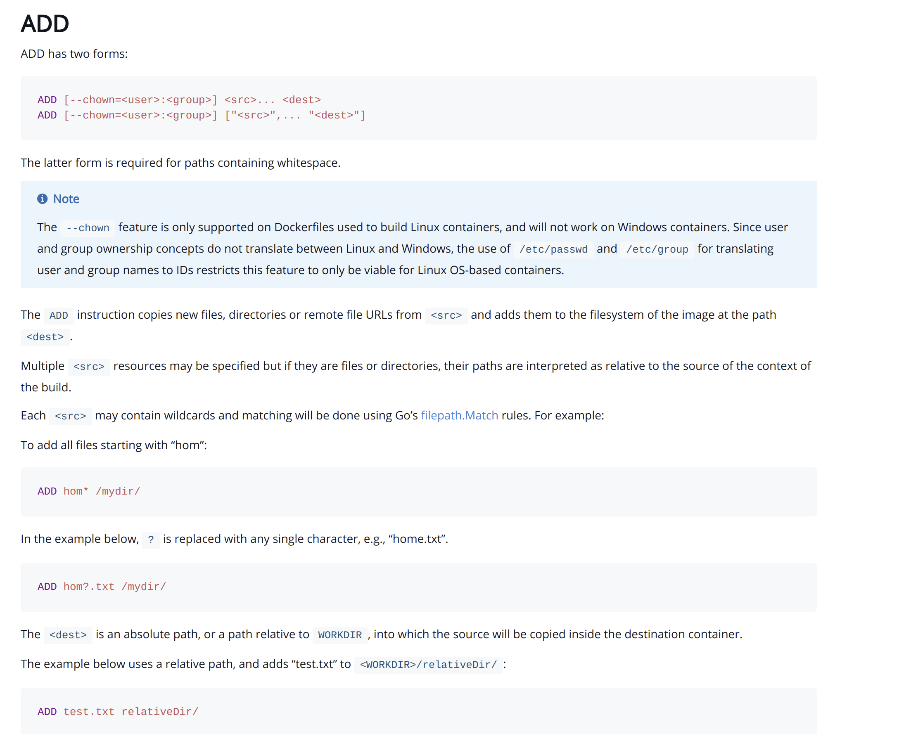

Slide 18
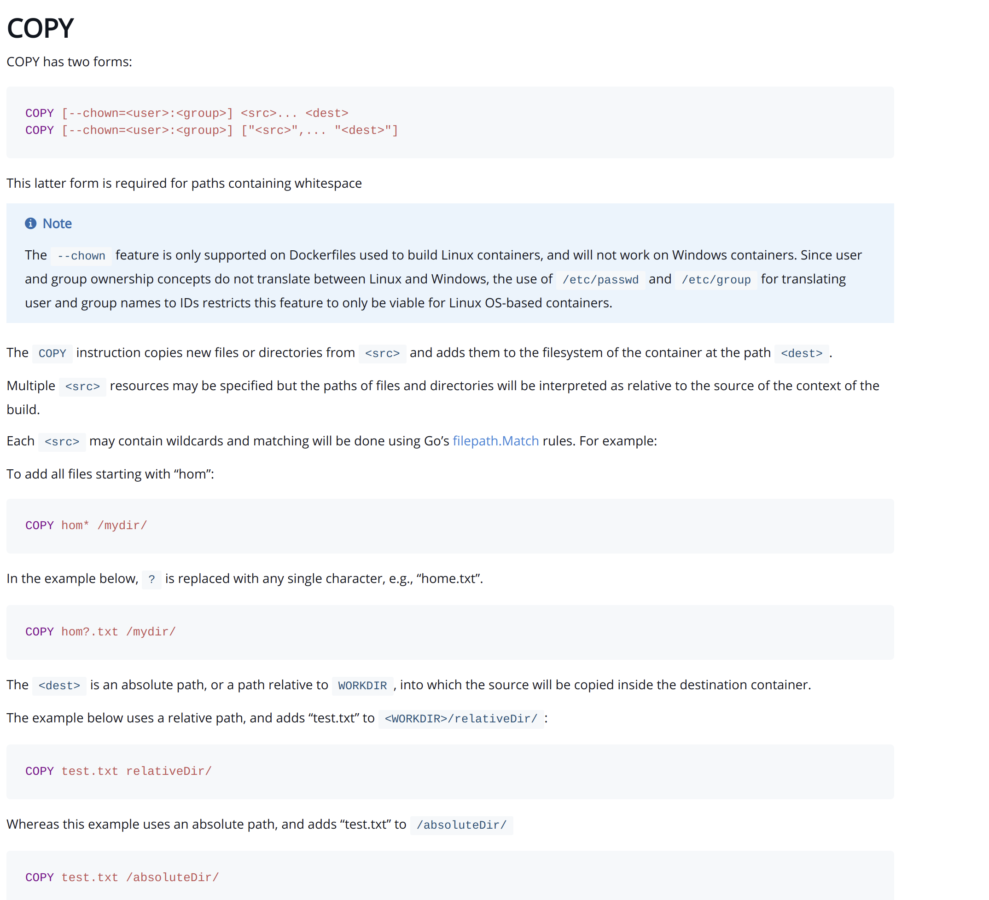

Slide 19
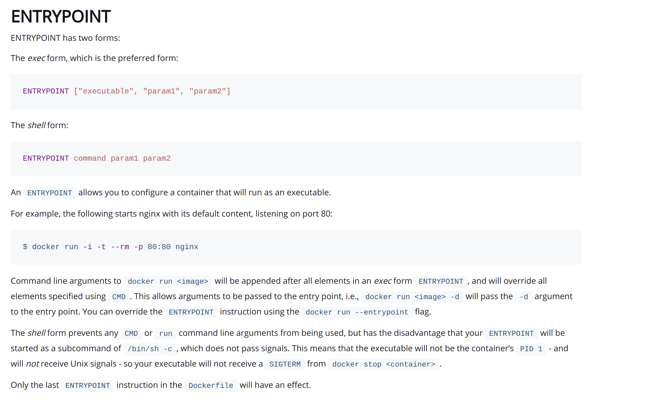

Slide 20
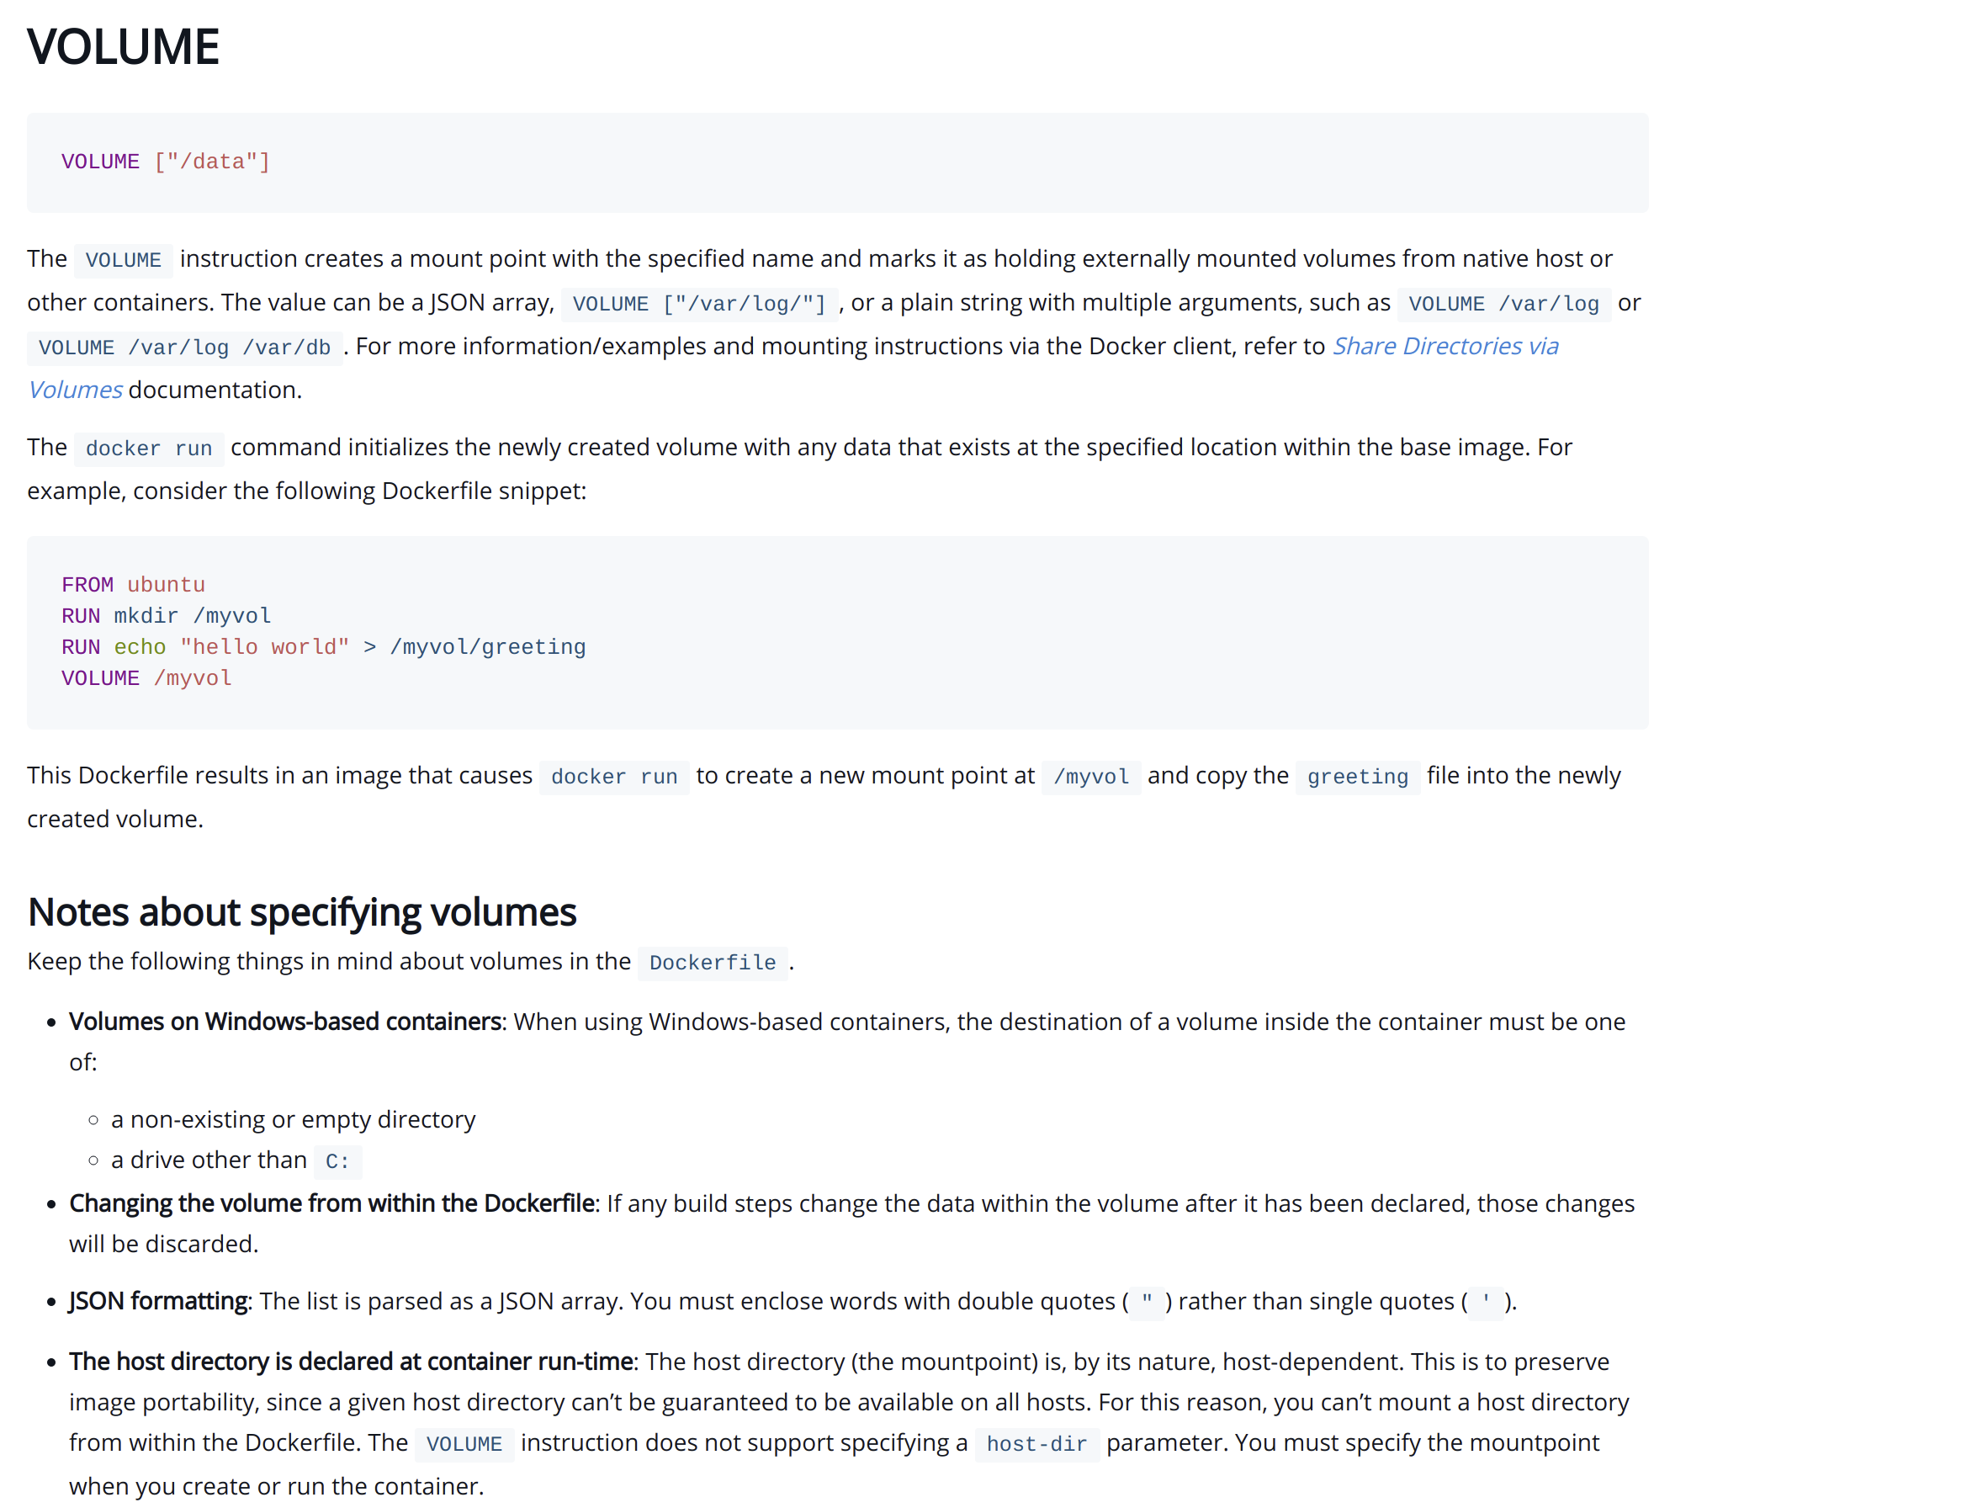

Slide 21
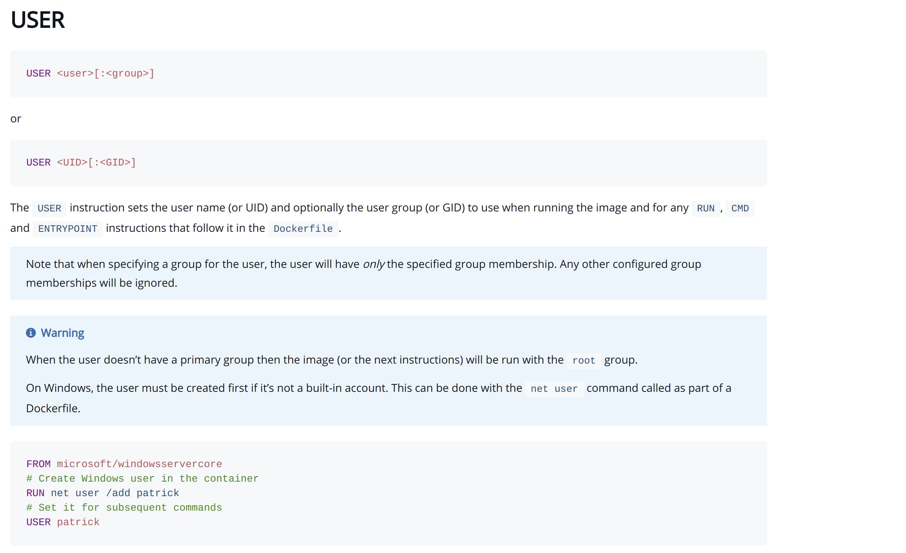

Slide 22
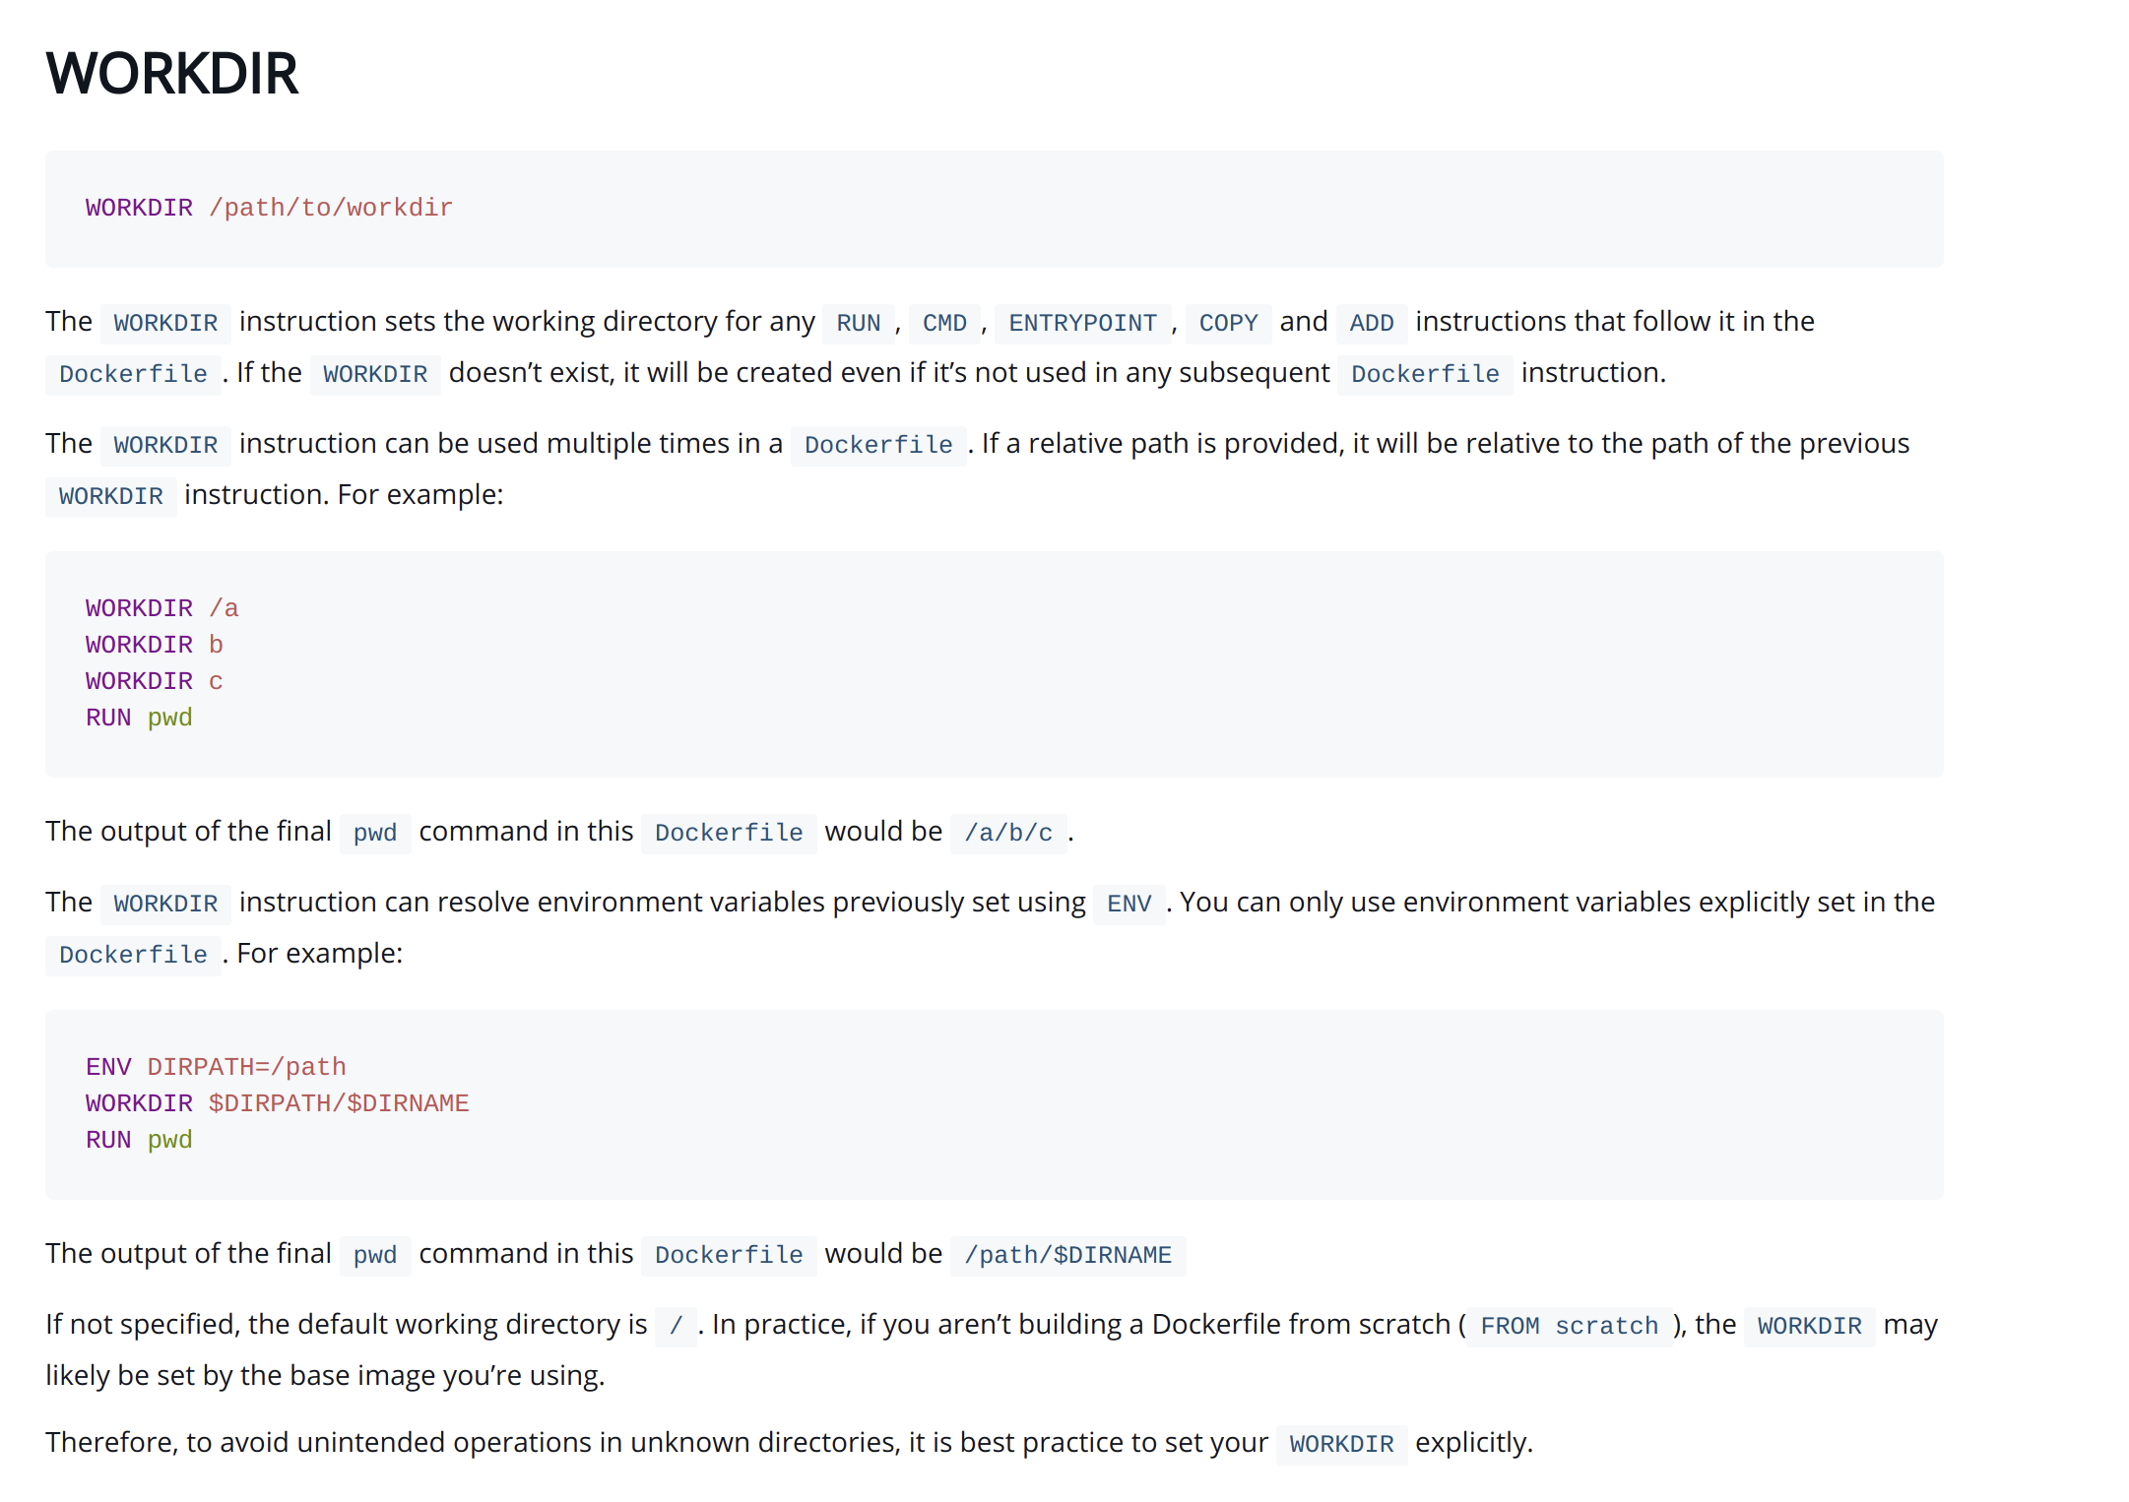

Slide 23
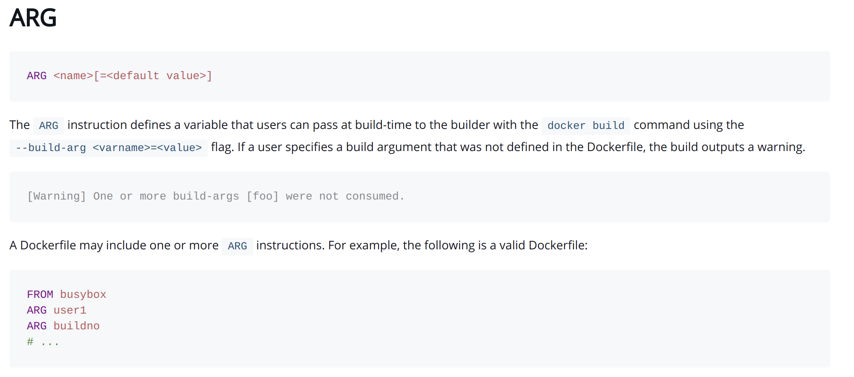

Slide 24
Each Dockerfile Command Creates a Layer
…
EXPOSE
COPY
WORKDIR
RUN
FROM
Kernel
<number>
Notes:
<number>

Slide 25
Section 2:
Anatomy of a Docker Container Docker Volumes
Volume Use Cases
Notes:
<number>

Slide 26
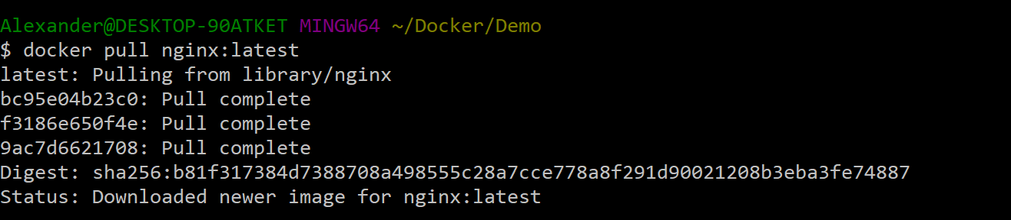
Docker Image Pull: Pulls Layers
<number>
Notes:
<number>

Slide 27
Docker Volumes
Volumes mount a directory on the host into the container at a specific location
Can be used to share (and persist) data between containers
Directory persists after the container is deleted
Unless you explicitly delete it
Can be created in a Dockerfile or via CLI
<number>
Notes:
<number>

Slide 28
Why Use Volumes
Mount local source code into a running container
docker container run -v $(pwd):/usr/src/app/ myapp
Improve performance
− As directory structures get complicated traversing the tree can slow system performance
Data persistence
<number>
Notes:
<number>

Slide 29

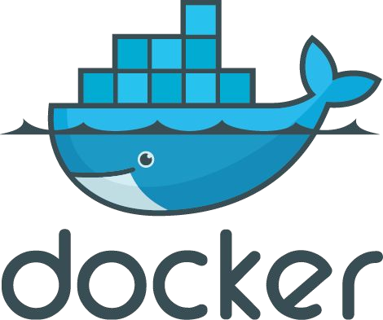
Section 3: Networking

Slide 30

What is Docker Bridge Networking
Docker host
Docker host
Cntnr 1
Cntnr 2
Cntnr 3
Cntnr 4
Cntnr 5
Cntnr 6
Cntnr 7
bridgenet1
bridgenet2
bridgenet3
docker network create -d bridge --name bridgenet1
<number>

Slide 31


Docker Bridge Networking and Port Mapping
Docker host 1
Host port
Container port
Cntnr1
10.0.0.8
:80
$ docker container run -p 8080:80 ...
Bridge
172.14.3.55
:8080
L2/L3 physical network
<number>

Slide 32
Section 4: Docker Compose
Notes:
<number>

Slide 33




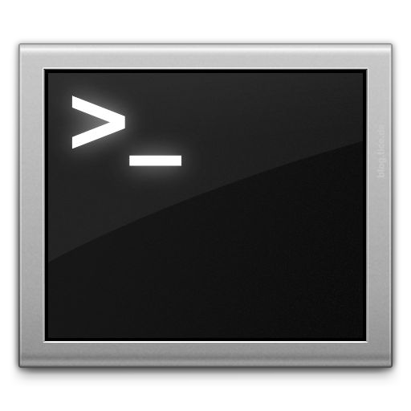







Docker Compose: Multi Container Applications
Build and run one container at a time
Manually connect containers together
Must be careful with dependencies and start up order
Define multi container app in compose.yml file
Single command to deploy entire app
Handles container dependencies
Works with Docker Swarm, Networking, Volumes, Universal Control Plane
49
Notes:
<number>

Slide 34

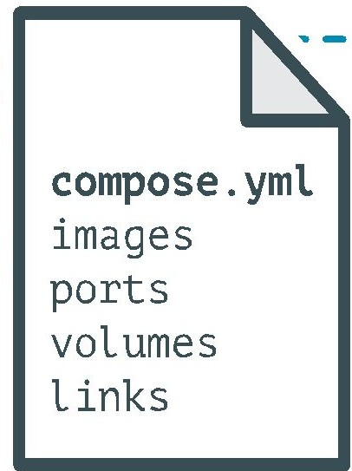
Docker Compose: Multi Container Applications
version: '2' # specify docker-compose version
# Define the services/containers to be run
services:
angular: # name of the first service
build: client # specify the directory of the Dockerfile
ports:
- "4200:4200" # specify port forewarding
express: #name of the second service
build: api # specify the directory of the Dockerfile
ports:
- "3977:3977" #specify ports forewarding
database: # name of the third service
image: mongo # specify image to build container from
ports:
- "27017:27017" # specify port forewarding
Notes:
<number>

Slide 35
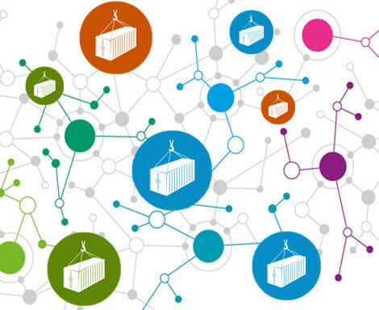
Docker Compose: Scale Container Applications
Notes:
<number>

Slide 36



Demo
Angular
Node.js/Express
Mongo DB
Notes:
<number>

Slide 37
Notes:
<number>

